Slide 1
An overview of gradient descent optimization algorithms
2016.03.29

Slide 2
Table of Contents
Gradient descent variants
Batch、Stochastic、Mini-batch
Challenges
Gradient descent optimization algorithms
Momentum、Nesterov accelerated gradient
Adagrad、Adadelta、RMSprop
Visualization of algorithms

Slide 3

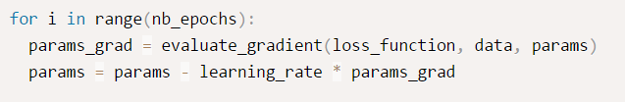
Batch gradient descent
computes the gradient of the cost function
w.r.t. to the parameters θ for the entire training dataset:
Very slow
doesn't allow us to update our model online
Much of memory

Slide 4

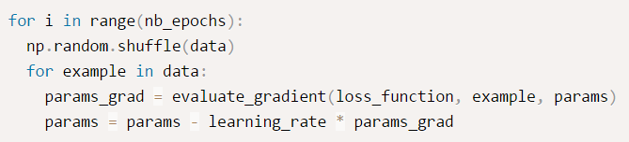
Stochastic gradient descent
performs a parameter update for each training example x(i) and label y(i):
frequent updates with a high variance
the objective function to fluctuate heavily

Slide 5
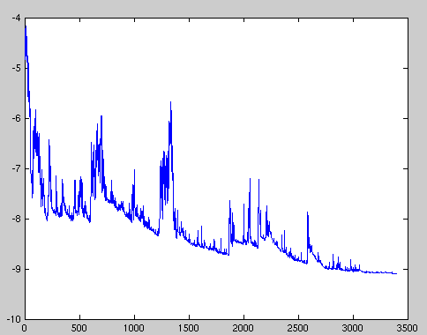
Stochastic gradient descent

Slide 6

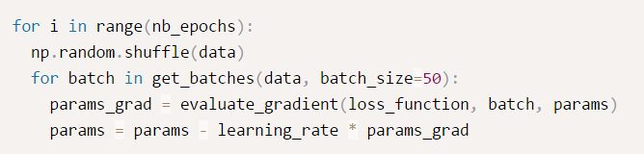
Mini-batch gradient descent
performs an update for every mini-batch of n training examples:
reduces the variance of the parameter updates, more stable convergence
can make use of highly optimized matrix optimizations

Slide 7
Challenges
mini-batch gradient descent does not guarantee good convergence
Choosing a proper learning rate can be difficult
Learning rate schedules try to adjust the learning rate during training by e.g. annealing
the same learning rate applies to all parameter updates
minimizing highly non-convex error functions is avoiding getting trapped in their numerous suboptimal local minima
the difficulty arises in fact not from local minima but from saddle points

Slide 8
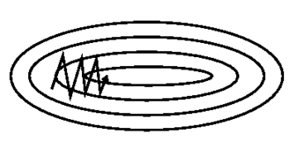
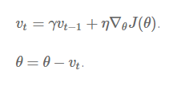
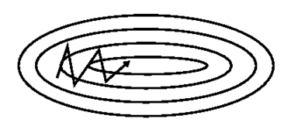
Momentum
SGD has trouble navigating ravines.
i.e. areas where the surface curves much
more steeply in one dimension than
in another
Momentum helps Accelerate SGD in the relevant direction and dampens oscillations, adding a fraction γ of the update vector of the past time step to the current update vector:

Slide 9

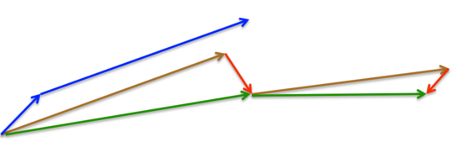
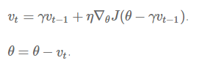
Nesterov accelerated gradient
blindly following the slope, is highly unsatisfactory.
has a notion to slow down before the hill slopes up again
Computing thus gives us an approximation of the next position of the parameters

Slide 10
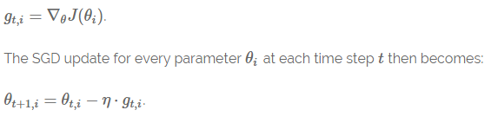
Adagrad
It adapts the learning rate to the parameters, performing larger updates for infrequent and smaller updates for frequent parameters
we set to be the gradient of the objective function w.r.t. to the parameter at time step t:
Adagrad modifies the general learning rate η at each time step t for every parameter based on the past gradients that have been computed for :
Notes:
it is well-suited for dealing with sparse data. Dean et al. [⁴] have found that Adagrad greatly improved the robustness of SGD and used it for training large-scale neural nets at Google, which -- among other things -- learned to recognize cats in Youtube videos. Moreover, Pennington et al. [⁵] used Adagrad to train GloVe word embeddings, as infrequent words require much larger updates than frequent ones.

Slide 11



Adagrad
here is a diagonal matrix where each diagonal element i,i is the sum of the squares of the gradients w.r.t. up to time step t
Benefits: eliminates the need to manually tune the learning rate
Weakness: the learning rate to shrink and eventually become infinitesimally small
Notes:
The following algorithms aim to resolve this flaw

Slide 12

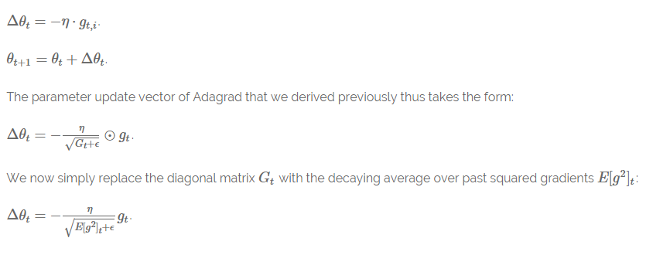
Adadelta
Instead of accumulating all past squared gradients, Adadelta restricts the window of accumulated past gradients to some fixed size w

Slide 13

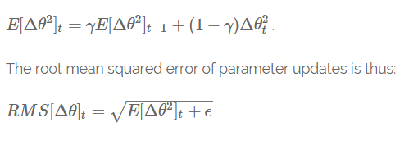
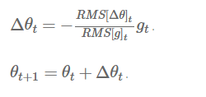
Adadelta

Slide 14
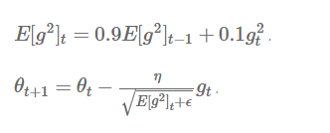
RMSprop

Slide 15
Visualization of algorithms

Slide 16
Visualization of algorithms

Slide 17

Thank You

